Slide 1
LSDA Final Project
Name: Medvegy Gábor
Neptun: SZHNB1

Slide 2
Business Goal
What are the most important factors influencing median house prices of neighborhoods in California, and implicitly, where should one look if they want to find affordable housing there?

Slide 3
Dataset
California housing data derived from the 1990 census.
longitude
latitude
housing_median_age
total_rooms
total_bedrooms
population
households
median_income
median_house_value
ocean_proximity

Slide 4
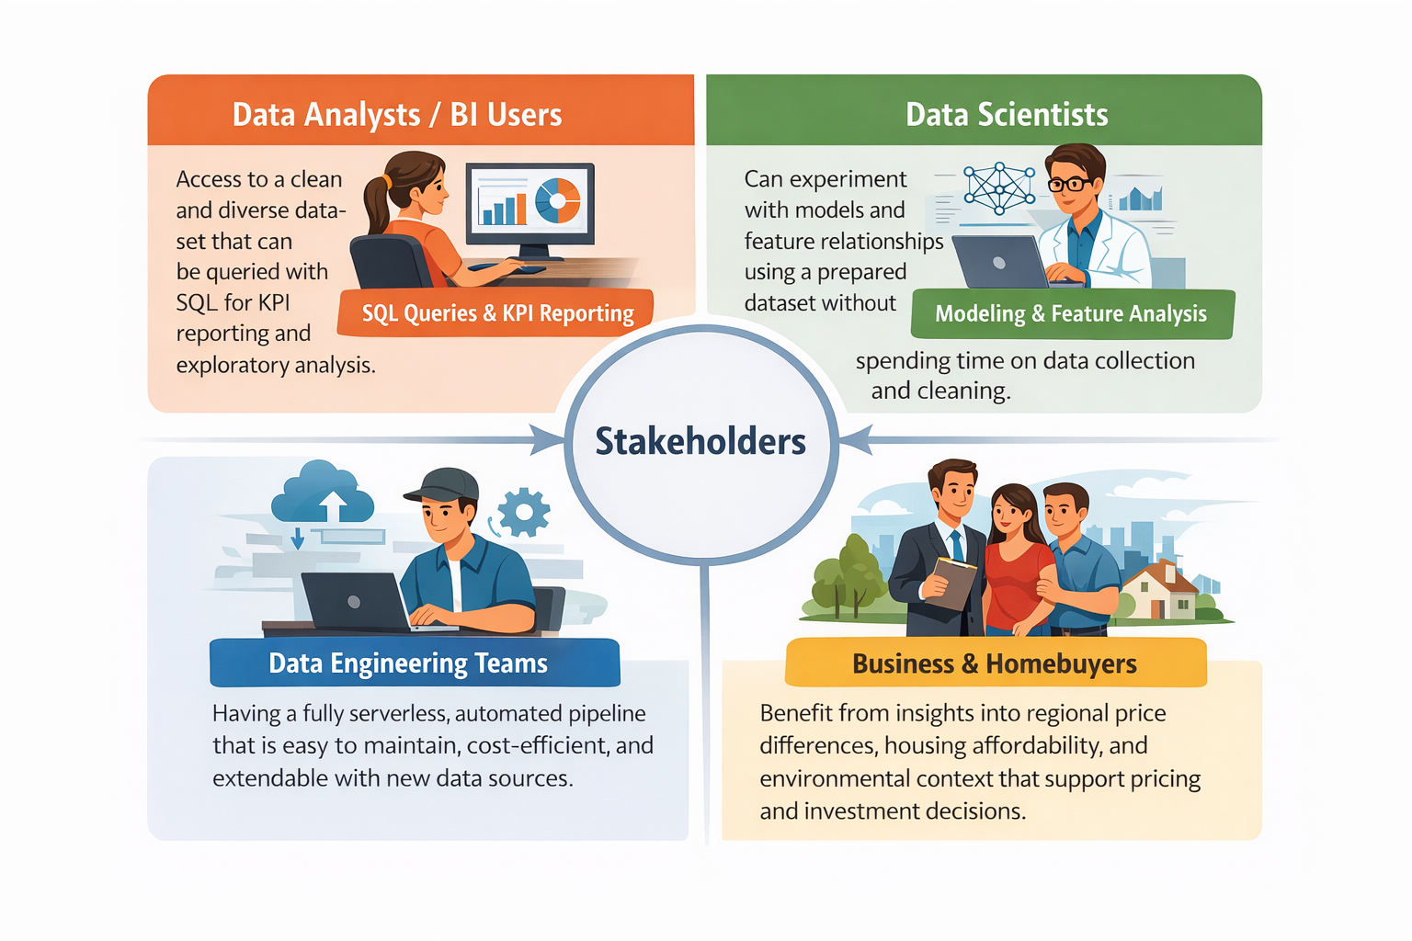
Stakeholders & Value

Slide 5
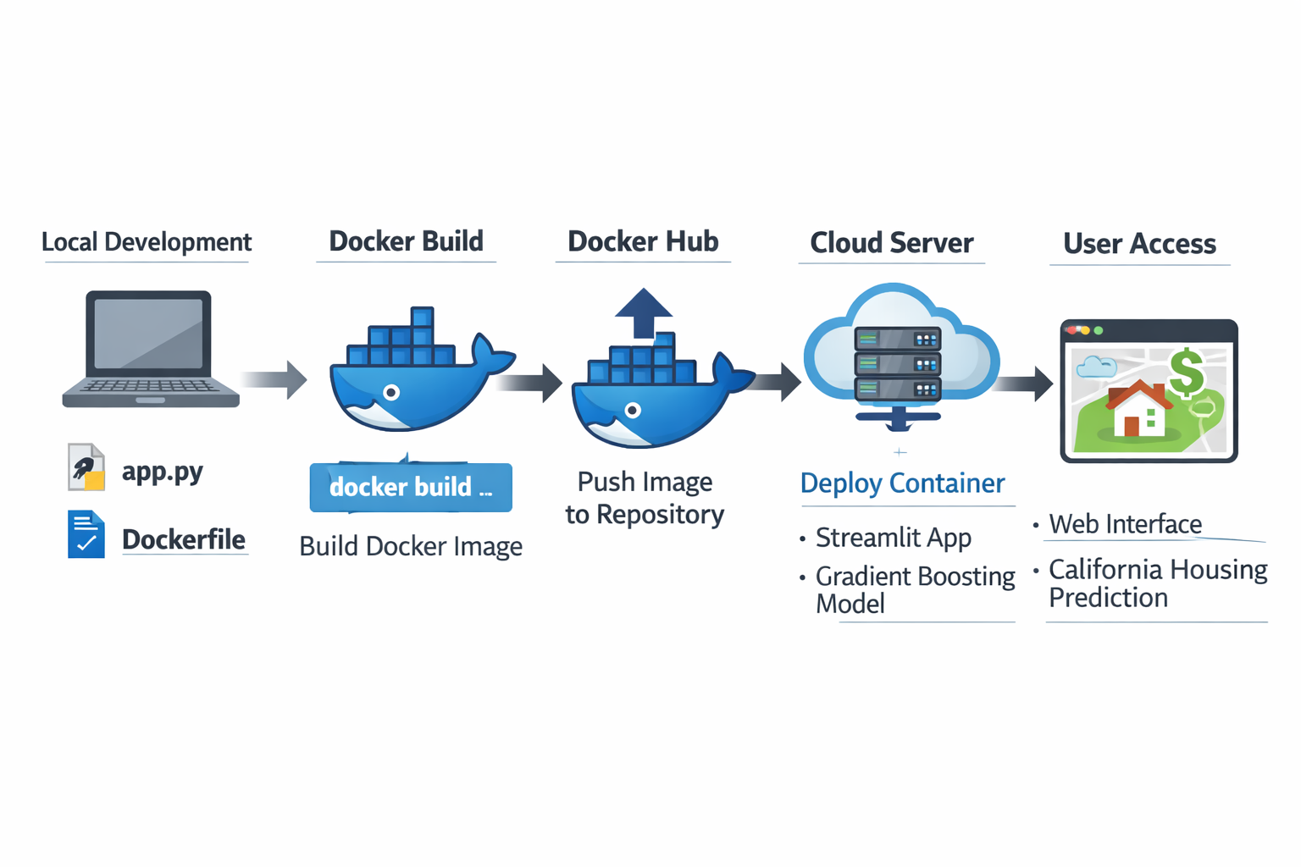
Docker
Local development: Built the Streamlit app and the dependencies in a Dockerfile.
Docker build: Created a portable Docker image with the app and all required libraries.
Registry: Pushed the image to a container registry for deployment.
Deployment: Pulled and ran the image as a container on a server.
User access: Users interact with the app through a web browser.

Slide 6
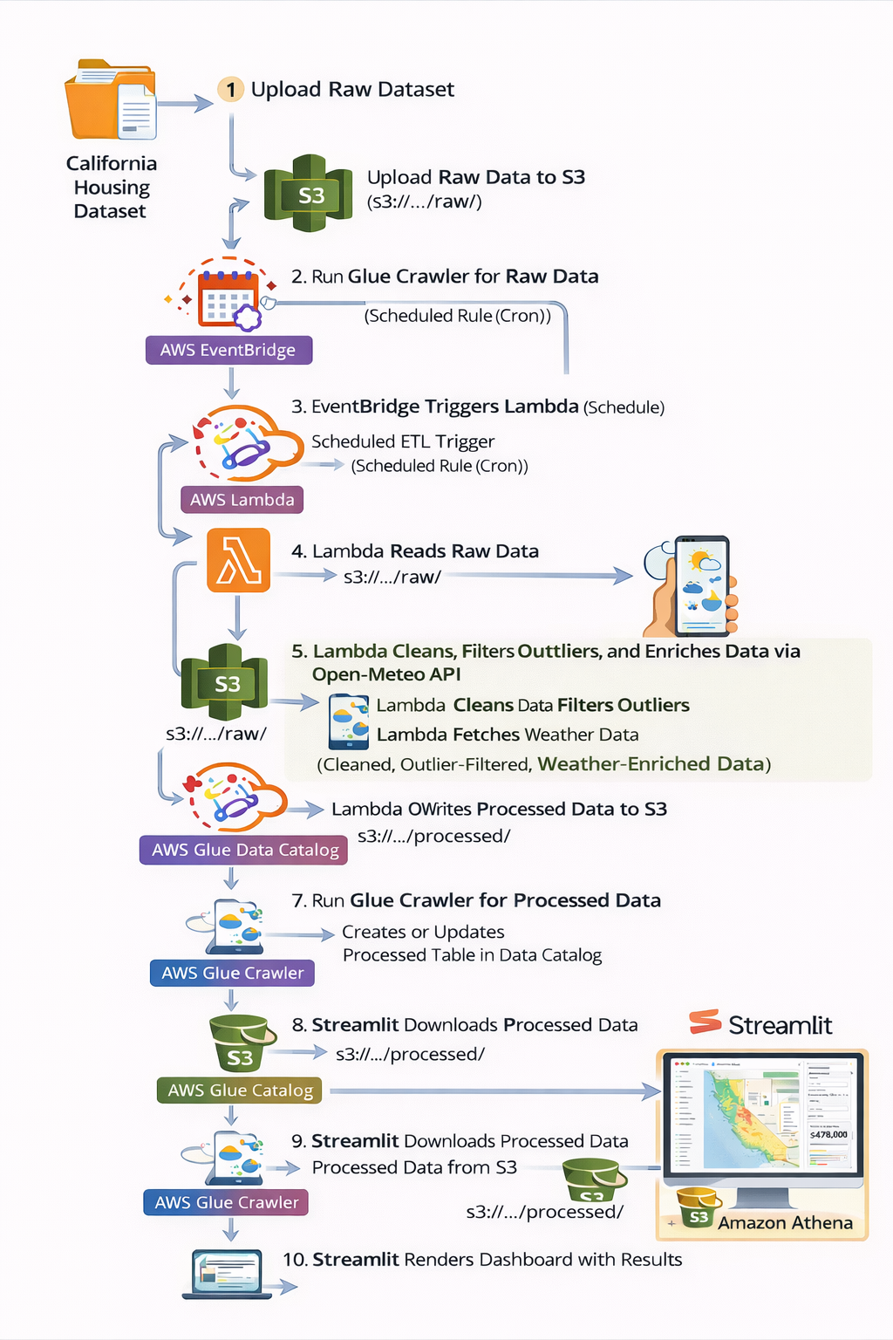
Data Pipeline & Architecture
Raw California housing data is uploaded to Amazon S3.
Amazon EventBridge triggers an AWS Lambda ETL job on a schedule.
Lambda cleans the data, handles missing values and outliers, samples the data, and enriches it with weather API data.
The processed dataset is saved back to Amazon S3.
An AWS Glue crawler catalogs the data for querying in Amazon Athena.
The final dataset is also used in a Streamlit app for visualizations and house price prediction.

Slide 7
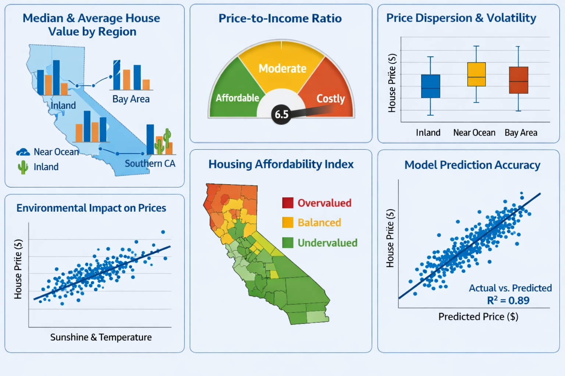
KPIs Supported by the pipeline

Slide 8
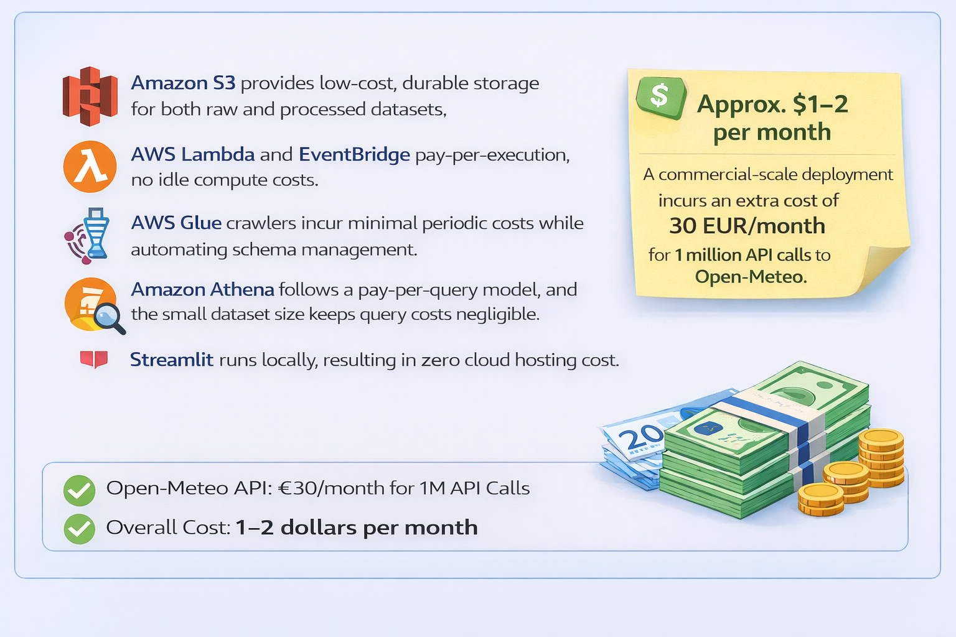
Costs

Slide 9
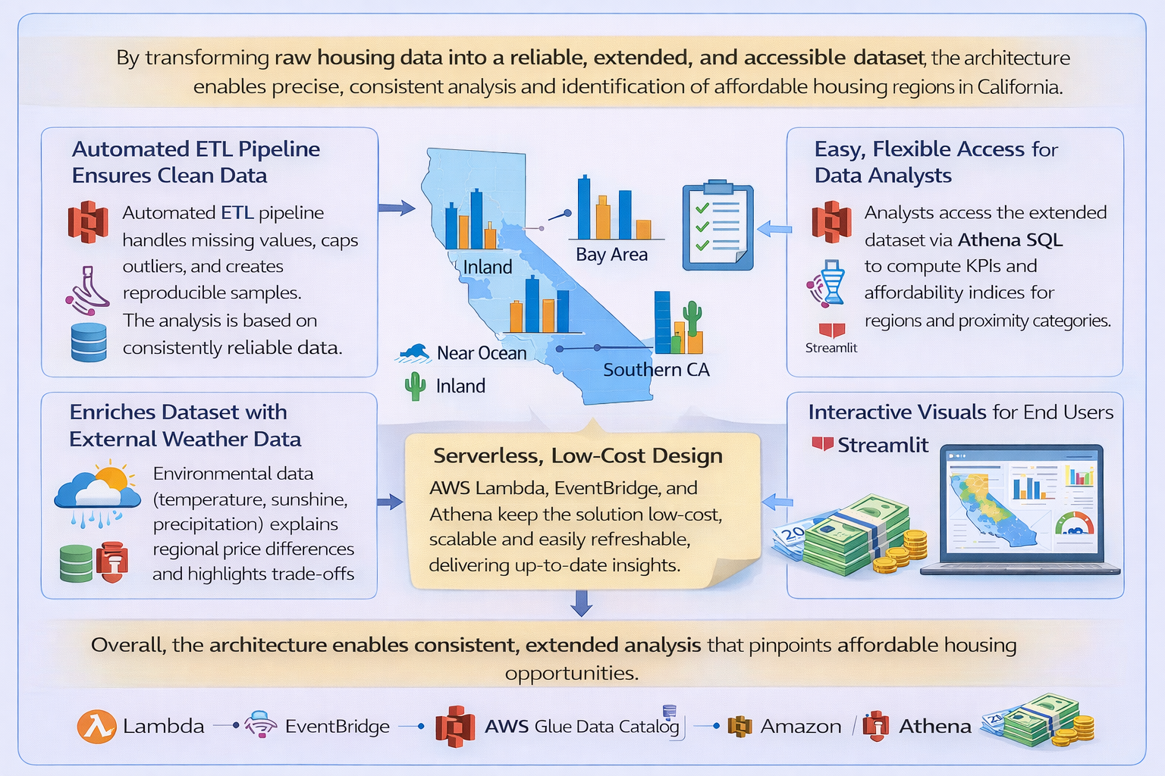
Goals Supported

Slide 10
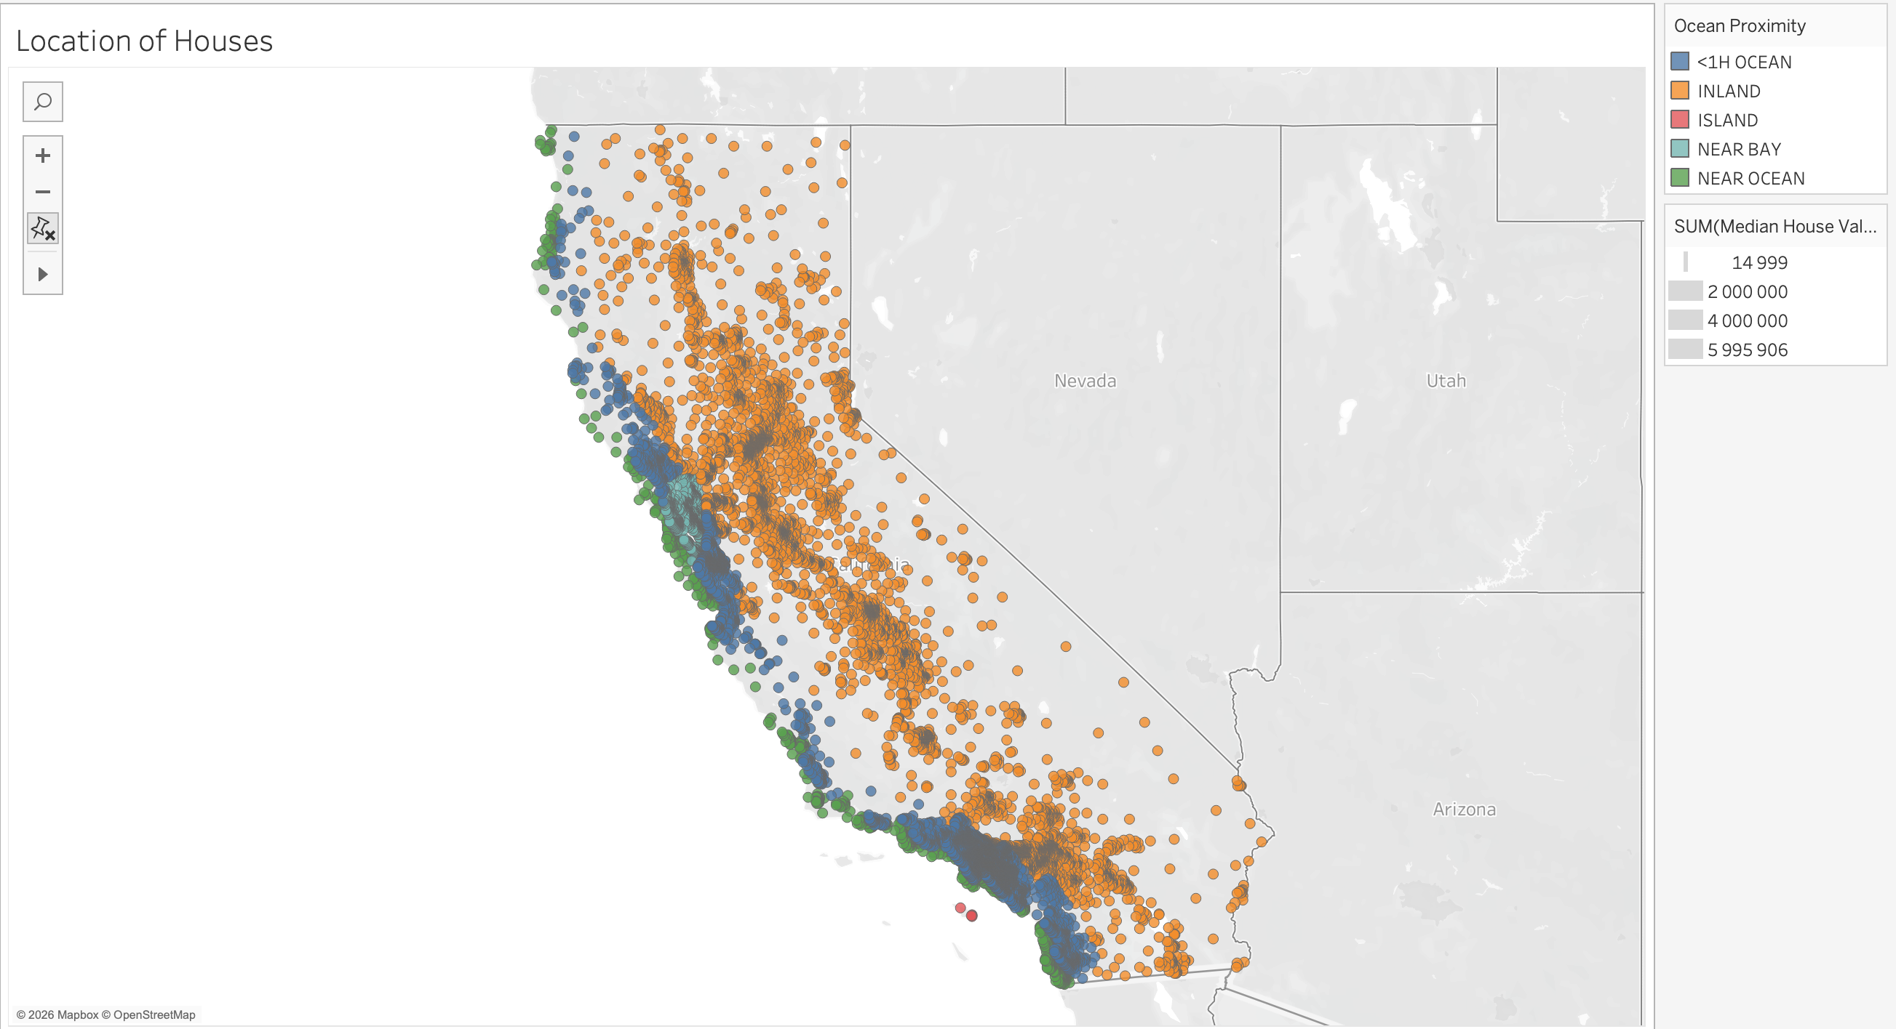
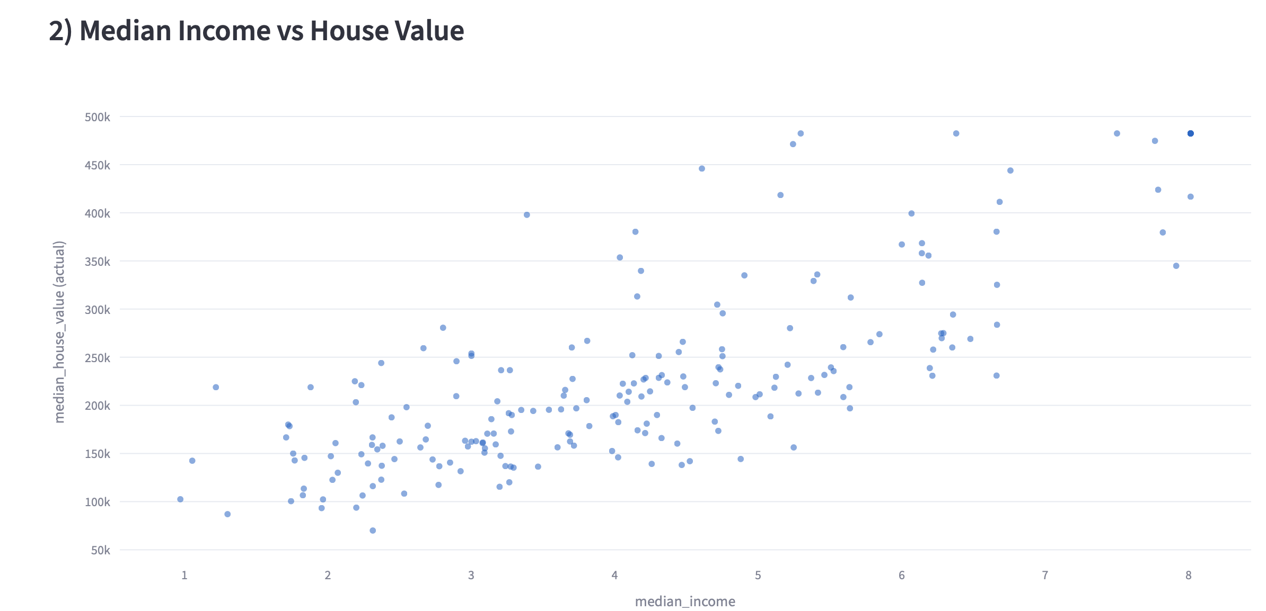
In Action

Slide 11
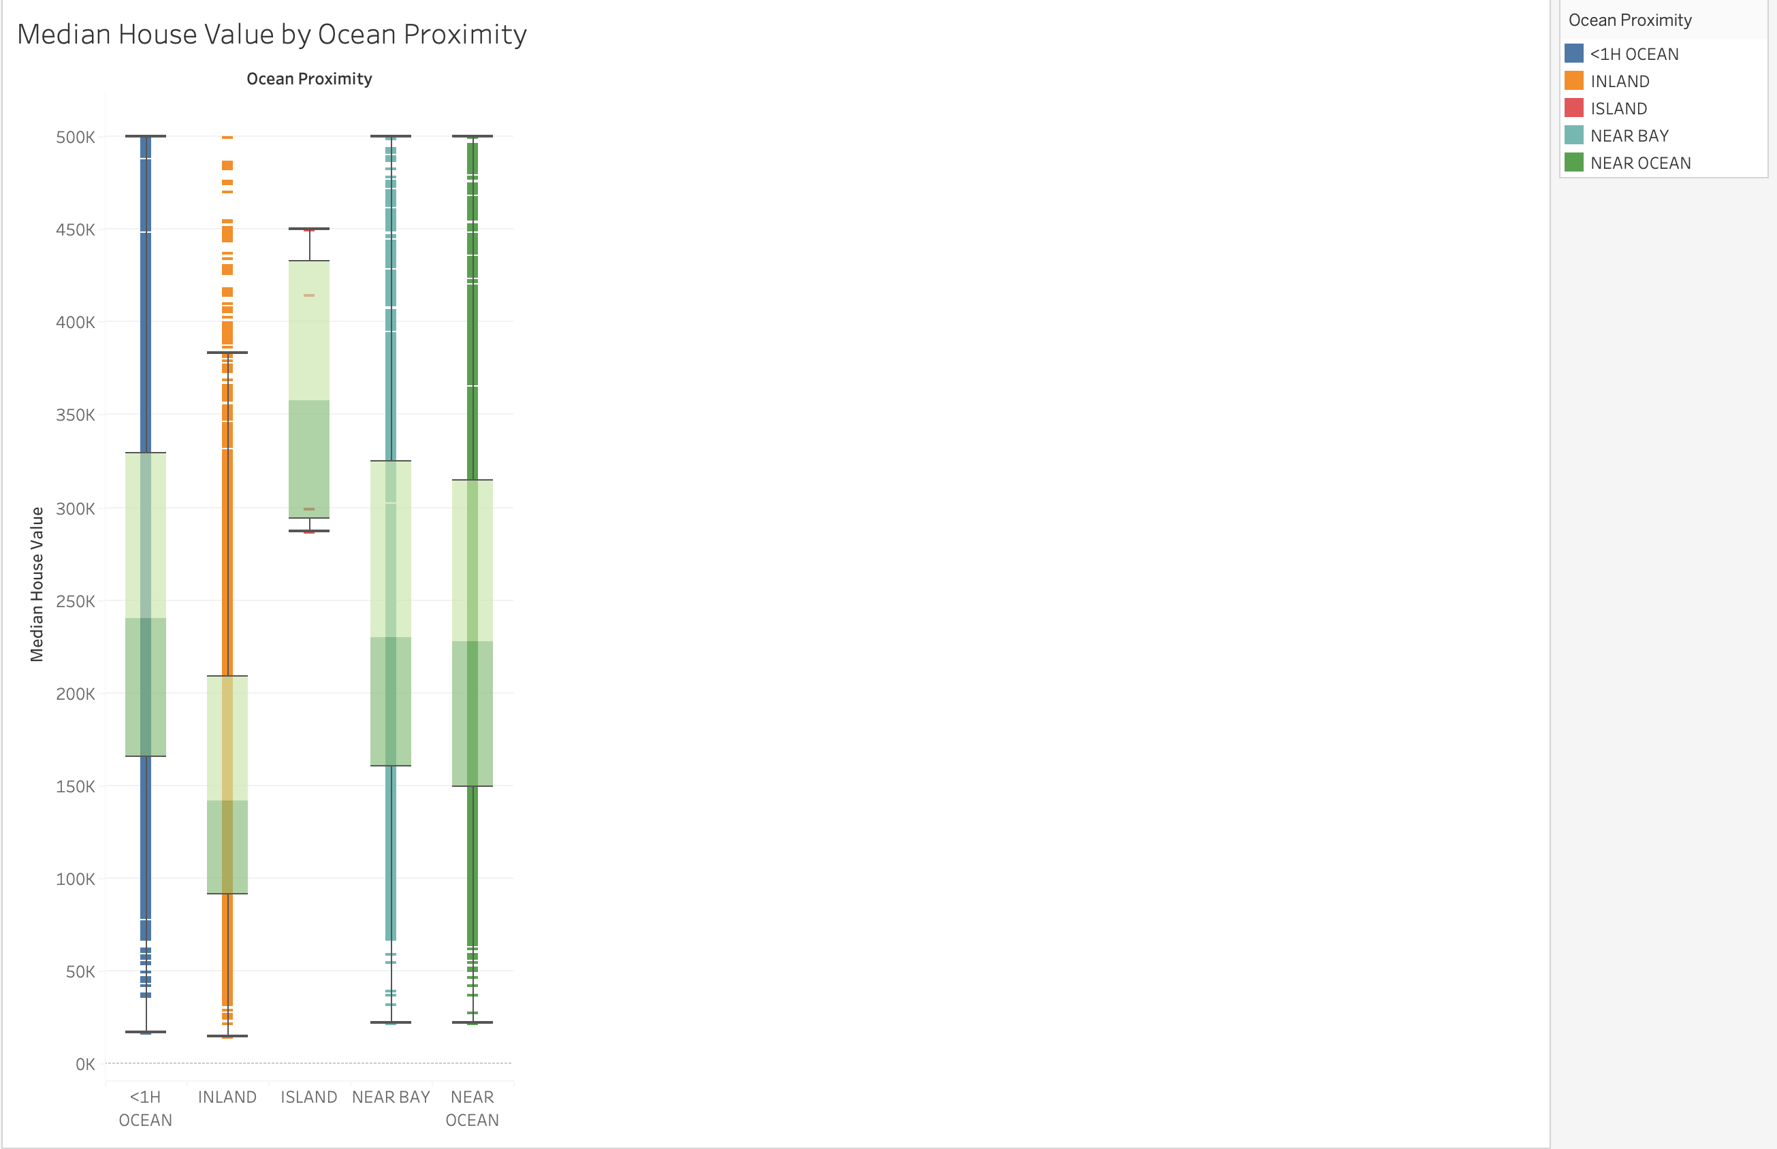
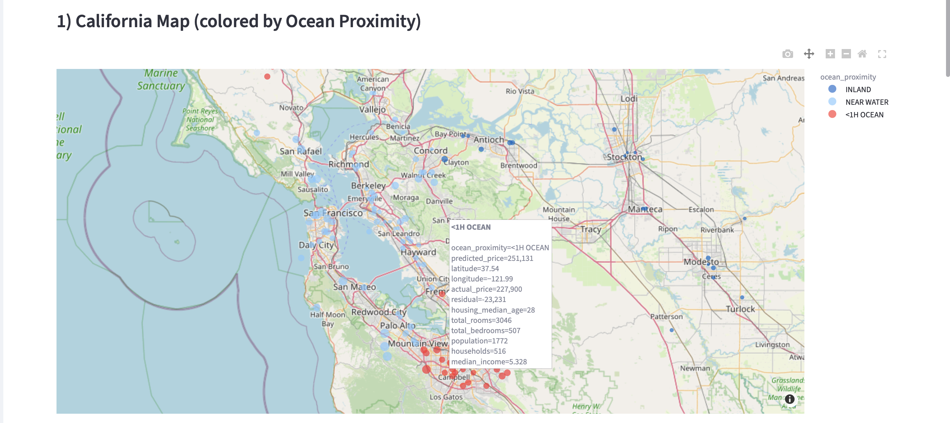
In Action

Slide 12
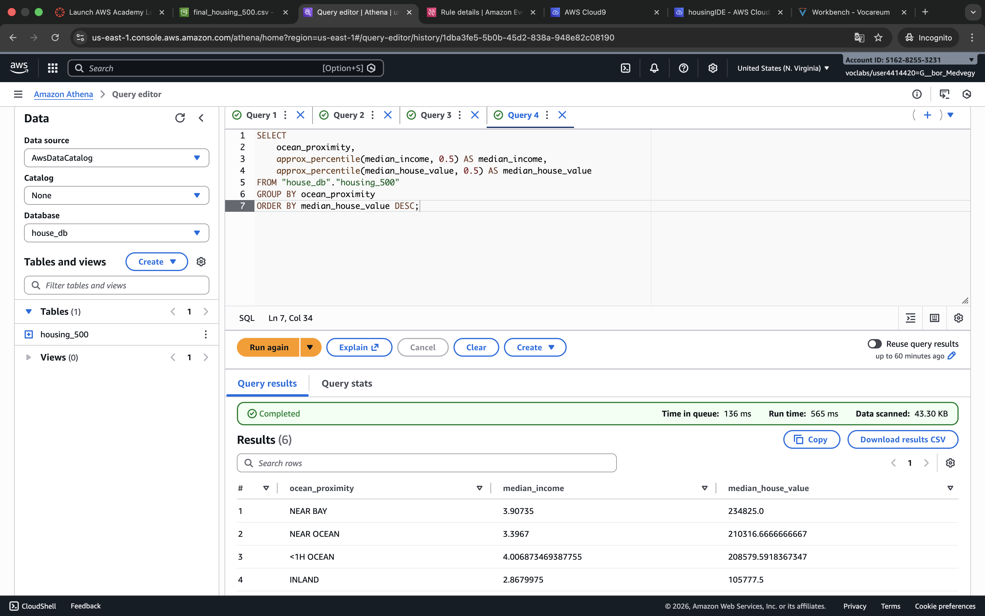
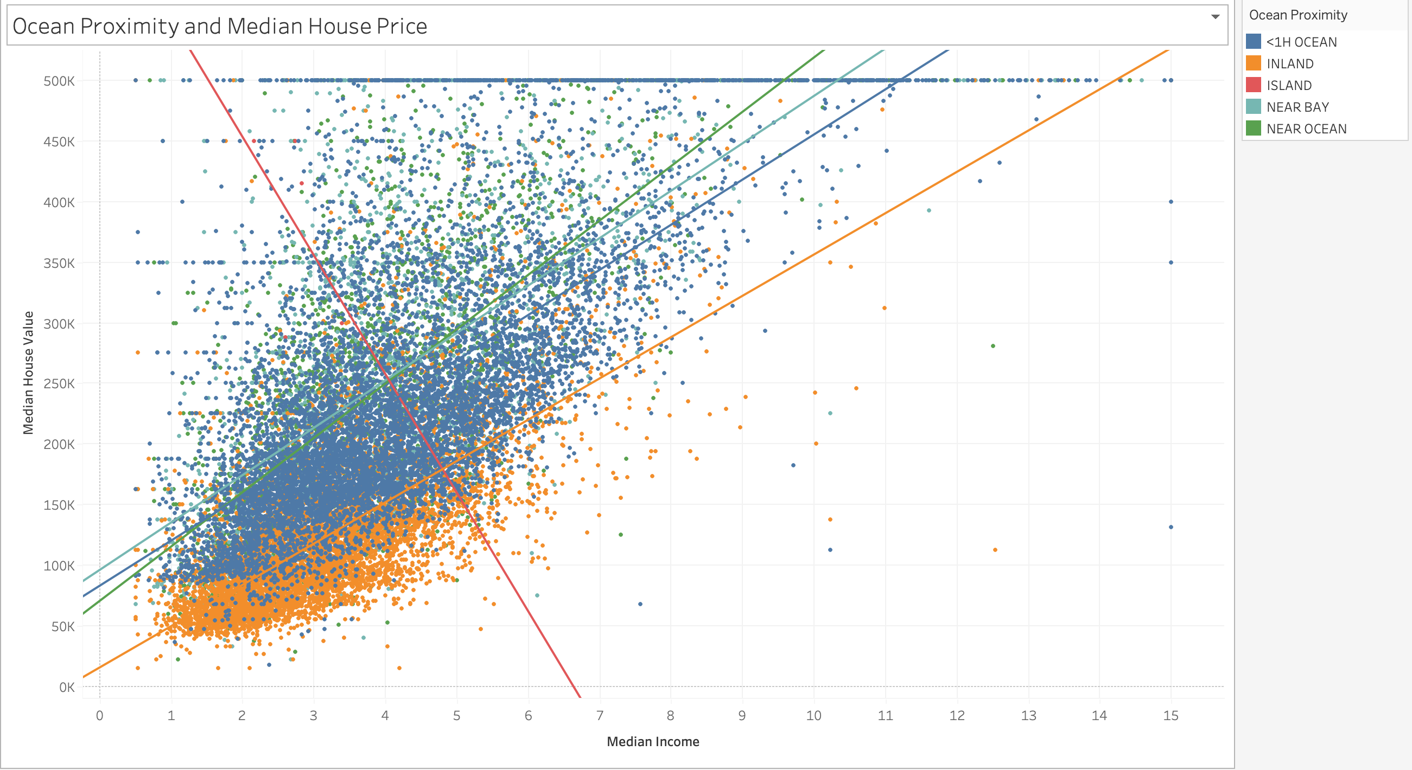
In Action

Slide 13
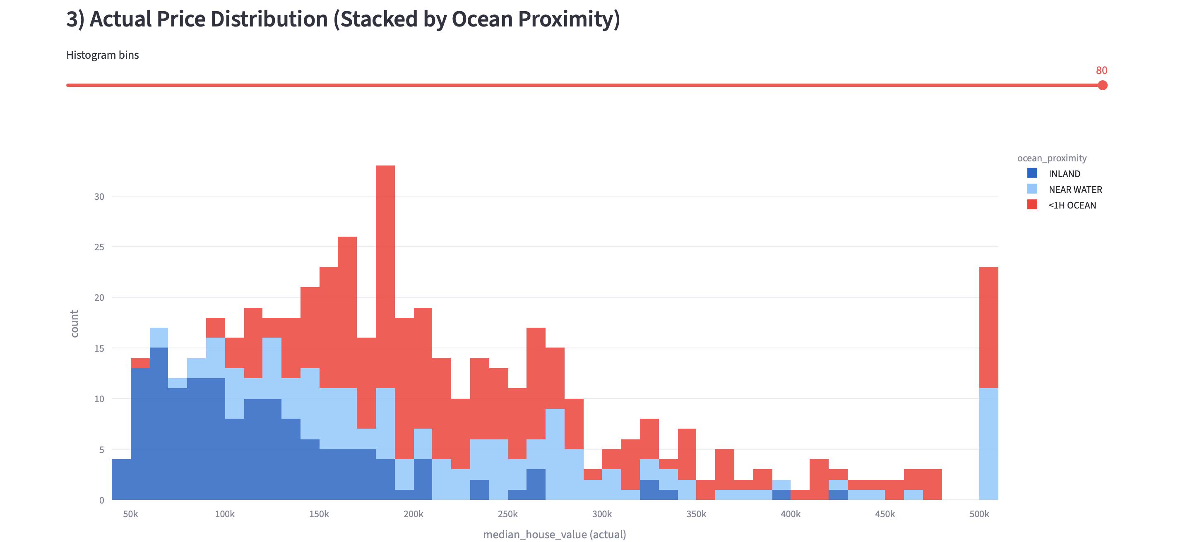
In Action

Slide 14
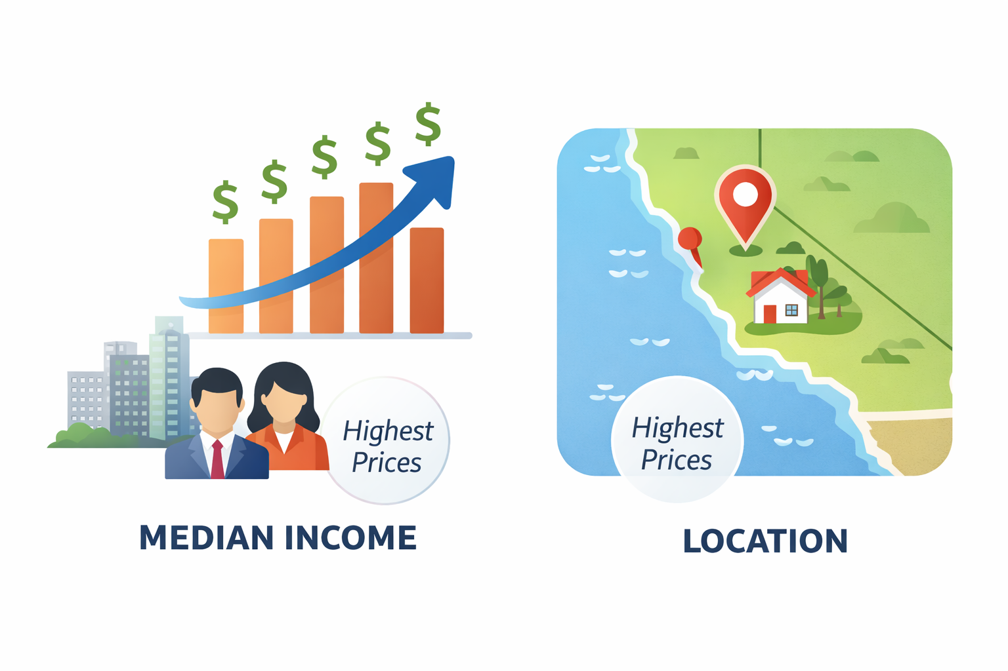
Results & Strongest Influences

Slide 15
Sources
Type | Source
California Housing Data | https://www.kaggle.com/datasets/camnugent/california-housing-prices
Weather Data | https://open-meteo.com
Cost Estimates | https://calculator.aws/#/
Charts & Images | https://gemini.google/hu/overview/image-generation/?hl=hu-HU

Slide 16
Thank you for your attention!
Questions?

